Slide 1

DEPENDENCY INJECTION
-Vishal Gangapuram

Slide 2

AGENDA
What is Dependency Injection ?
What are Dependencies ?
Problems without DI
Inversion of Control?
Types of DI
IOC Container
Service Life Time’s in DI
Advantages

Slide 3
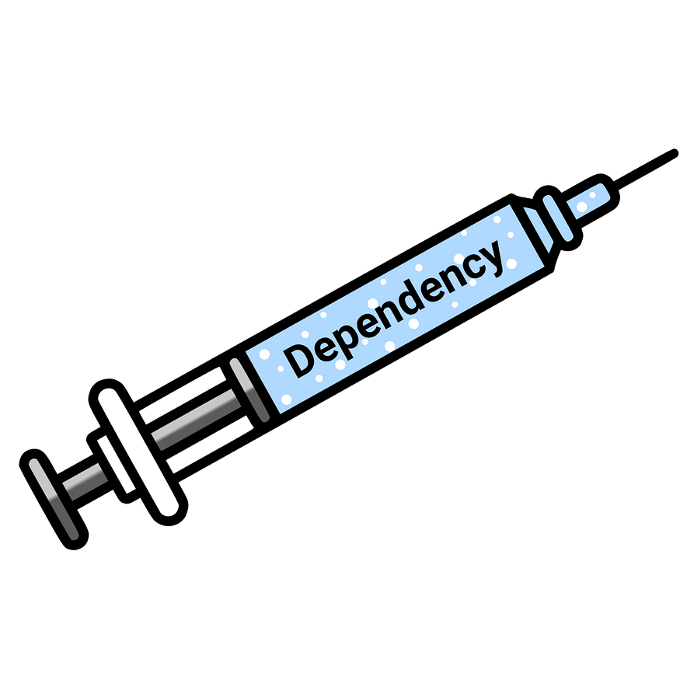
What is Dependency Injection ?
Dependency Injection is a software design pattern, which is a technique for achieving Inversion of Control (IoC) between classes and their dependencies.
The Dependency Injection is a design pattern that allows us to develop Loosely Coupled Software Components. In other words, we can say that it is used to reduce the Tight Coupling between the Software Components.

Slide 4
What is Dependency & Dependent Classes
dependent class
dependency class
Class A
Class B
Dependent classes are classes that rely on (or depend on) other classes to perform their functions.
Dependency classes are classes on which other classes are depended.

Slide 5

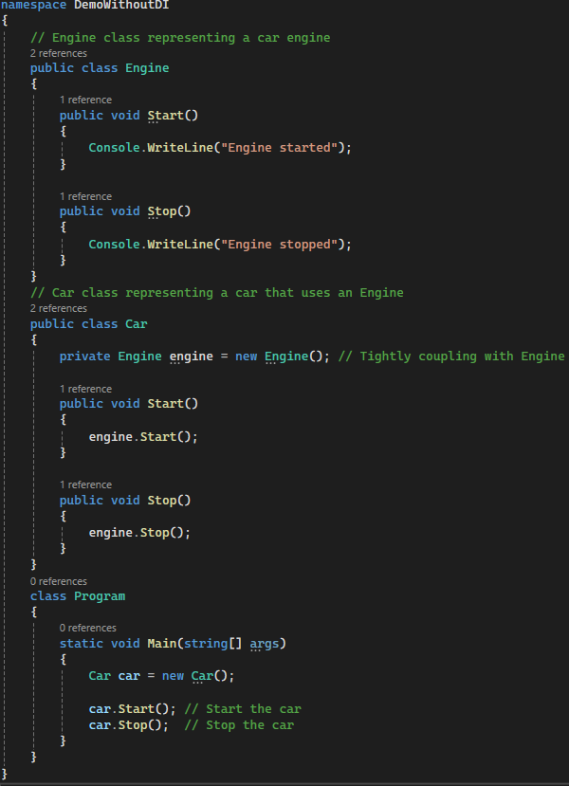
Tight Coupling
Classes in the application closely interdependent, making it difficult to modify or replace one component without affecting others.
dependent class
dependency class
CAR
ENGINE
The Car class creates an instance of the Engine class establishing a direct dependency between them.
If we wanted to change the type of engine used by the car (e.g., switch from gasoline engine to electric engine),we need to modify the Car class, making the code harder to maintain.

Slide 6
Inversion of Control
Inversion of Control (IoC) is a design principle which shifts control over object creation and dependencies from classes to an external classes, promoting loose coupling and code maintainable.
Interface I
CAR
IENGINE
In the above diagram, class Engine implements interface I, and class Car uses an instance of I instead of class Engine.
In the above implementation class Car uses class Engine but the interesting fact is that class Car doesn’t know that. It just knows that it uses something that implements interface I.
ENGINE

Slide 7
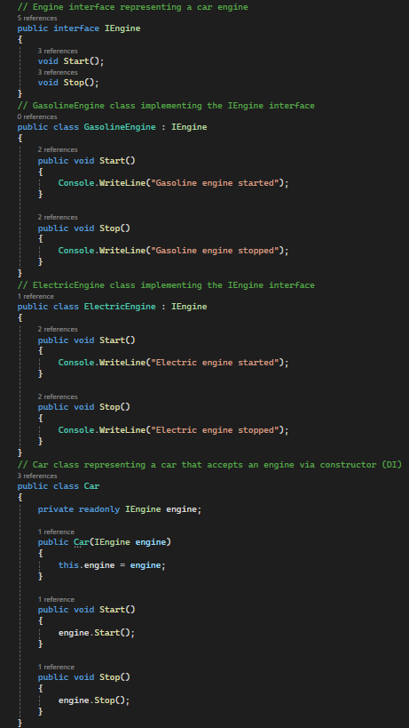
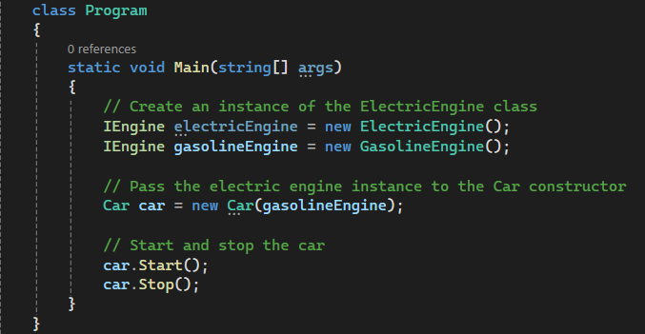
Inversion of Control
The Engine class implements an IEngine interface, providing a contract for engine functionality.
The Car class now accepts an I Engine object via its constructor, allowing different engine implementations to be injected.

Slide 8
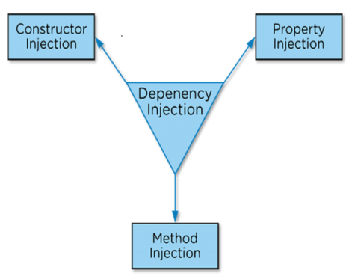
TYPES OF DI
When the Injector Injects the Dependency Object (i.e. Engine Object) into the Dependent Class through the Dependent Class Constructor, then it is called Constructor Dependency Injection.
Best for mandatory dependencies that must be provided at the time of object creation.
Suitable for classes with a small number of dependencies that are unlikely to change frequently.
CONSTRUCTOR INJECTION

Slide 9
TYPES OF DI
When the Injector Injects the Dependency Object (i.e. Engine Object) into the Dependent Class through the public Property of the Dependent Class, then it is called Property Dependency Injection. This is also called the Setter Injection.
Use when dependencies are optional or can be set after the object is created.
Allows for flexibility but can lead to objects being in an inconsistent state if not properly initialized.
PROPERTY INJECTION

Slide 10
TYPES OF DI
When the Injector Injects the Dependency Object (i.e. Engine Object) into the Dependent Class through a public Method of the Dependent Class, then it is called Method Dependency Injection..
Use when dependencies are required for specific methods but not for the entire lifetime of the class.
Provides fine-grained control over dependencies but can make code harder to follow if overused.
METHOD INJECTION

Slide 11
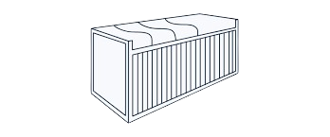
IOC Container
Resolve
Instance
Register
IoC Container is a framework for implementing automatic dependency injection. It manages object creation and it's life-time, and also injects dependencies to the class.
There are different IoC Containers available for .NET such as
Unity,
Ninject,
StructureMap,
Autofac

Slide 12
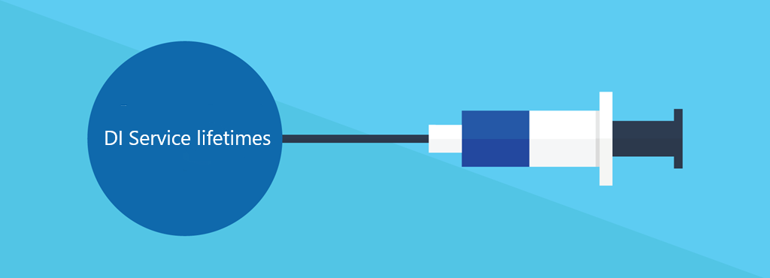
SERVICE LIFE TIMES
Scoped
A single instance is created and shared within the
scope of single HTTP request.
Scoped services are shared with in the scope.
Authentication, Database context
Transient
Singleton
A single instance is created and shared across the entire application’s lifetime.
Singleton services are shared globally.
Configuration settings, Logging services
A new instance is created every time the service is requested
Transient services are not shared.
unique identifier, Mapping services

Slide 13
ADVANTAGES
Reduce Tight coupling
Improve Testability
Increased maintainability
Scalability and Extensibility

Slide 14
THANK YOU!
-Vishal Gangapuram

